Slide 1

CHAPTER 1
SPEAKING
MATHEMATICALLY
Copyright © Cengage Learning. All rights reserved.

Slide 2
SECTION 1.2
The Language of Sets
Copyright © Cengage Learning. All rights reserved.

Slide 3
The Language of Sets

Slide 4
The Language of Sets
Use of the word set as a formal mathematical term was introduced in 1879 by Georg Cantor (1845–1918). For most mathematical purposes we can think of a set intuitively, as Cantor did, simply as a collection of elements.
For instance, if C is the set of all countries that are currently in the United Nations, then the United States is an element of C, and if I is the set of all integers from 1 to 100, then the number 57 is an element of I.

Slide 5
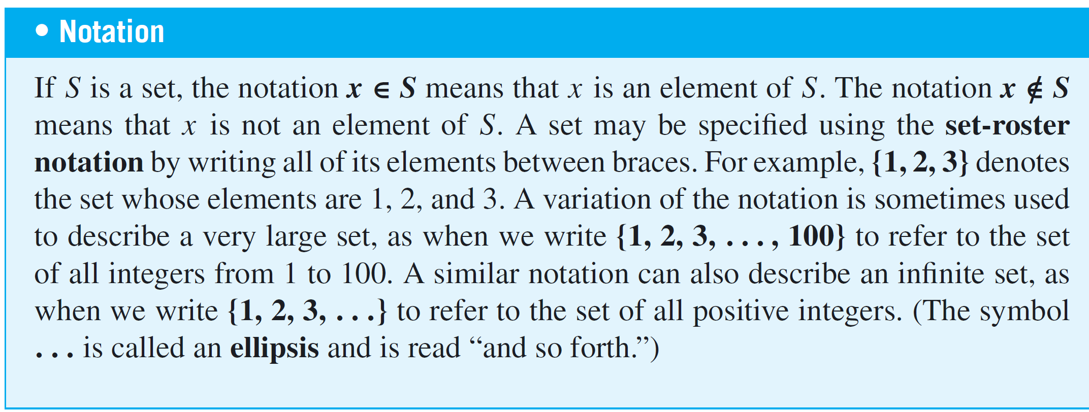
The Language of Sets
The axiom of extension says that a set is completely determined by what its elements are—not the order in which they might be listed or the fact that some elements might be listed more than once.

Slide 6
Example 1 – Using the Set-Roster Notation
a. Let A = {1, 2, 3}, B = {3, 1, 2}, and C = {1, 1, 2, 3, 3, 3}. What are the elements of A, B, and C? How are A, B, and C related?
b. Is {0} = 0?
c. How many elements are in the set {1, {1}}?
d. For each nonnegative integer n, let U_{n} = {n, –n}. Find U₁, U₂, and U₀.
Solution:
a. A, B, and C have exactly the same three elements: 1, 2,
and 3. Therefore, A, B, and C are simply different ways
to represent the same set.

Slide 7
Example 1 – Solution
cont’d
b. {0} ≠ 0 because {0} is a set with one element, namely 0,
whereas 0 is just the symbol that represents the number
zero.
c. The set {1, {1}} has two elements: 1 and the set whose
only element is 1.
d. U₁ = {1, –1}, U₂ = {2, –2}, U₀ = {0, –0} = {0, 0} = {0}.

Slide 8
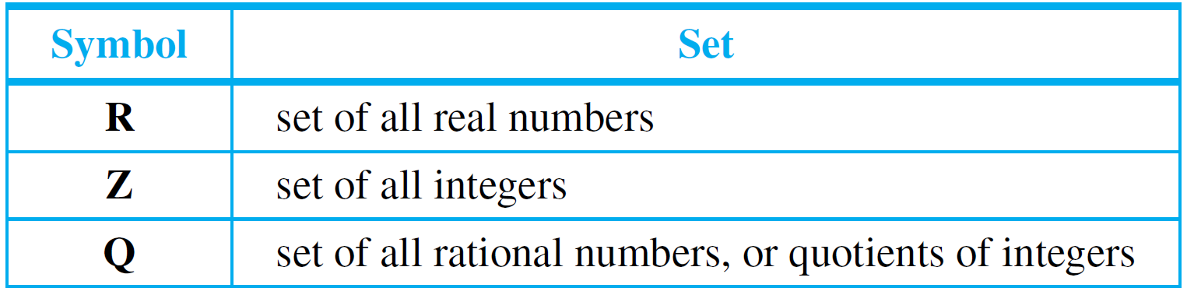
The Language of Sets
Certain sets of numbers are so frequently referred to that they are given special symbolic names. These are summarized in the following table:

Slide 9
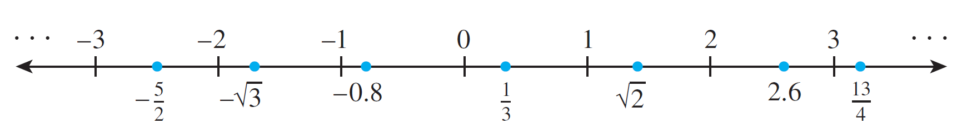
The Language of Sets
The set of real numbers is usually pictured as the set of all points on a line, as shown below.
The number 0 corresponds to a middle point, called the origin.
A unit of distance is marked off, and each point to the right of the origin corresponds to a positive real number found by computing its distance from the origin.

Slide 10
The Language of Sets
Each point to the left of the origin corresponds to a negative real number, which is denoted by computing its distance from the origin and putting a minus sign in front of the resulting number.
The set of real numbers is therefore divided into three parts: the set of positive real numbers, the set of negative real numbers, and the number 0.
Note that 0 is neither positive nor negative.

Slide 11
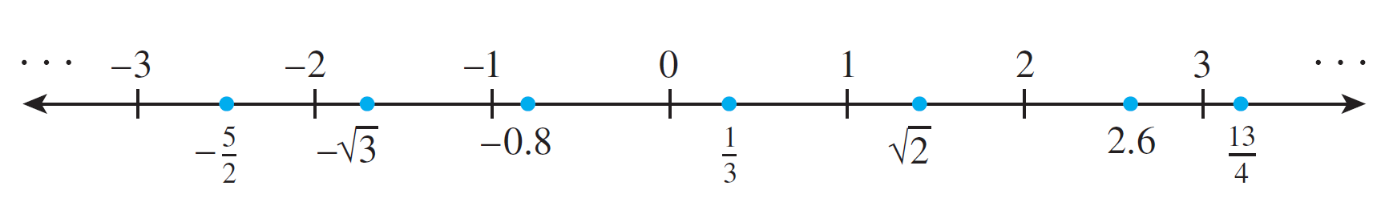
The Language of Sets
Labels are given for a few real numbers corresponding to points on the line shown below.
The real number line is called continuous because it is imagined to have no holes.
The set of integers corresponds to a collection of points located at fixed intervals along the real number line.

Slide 12
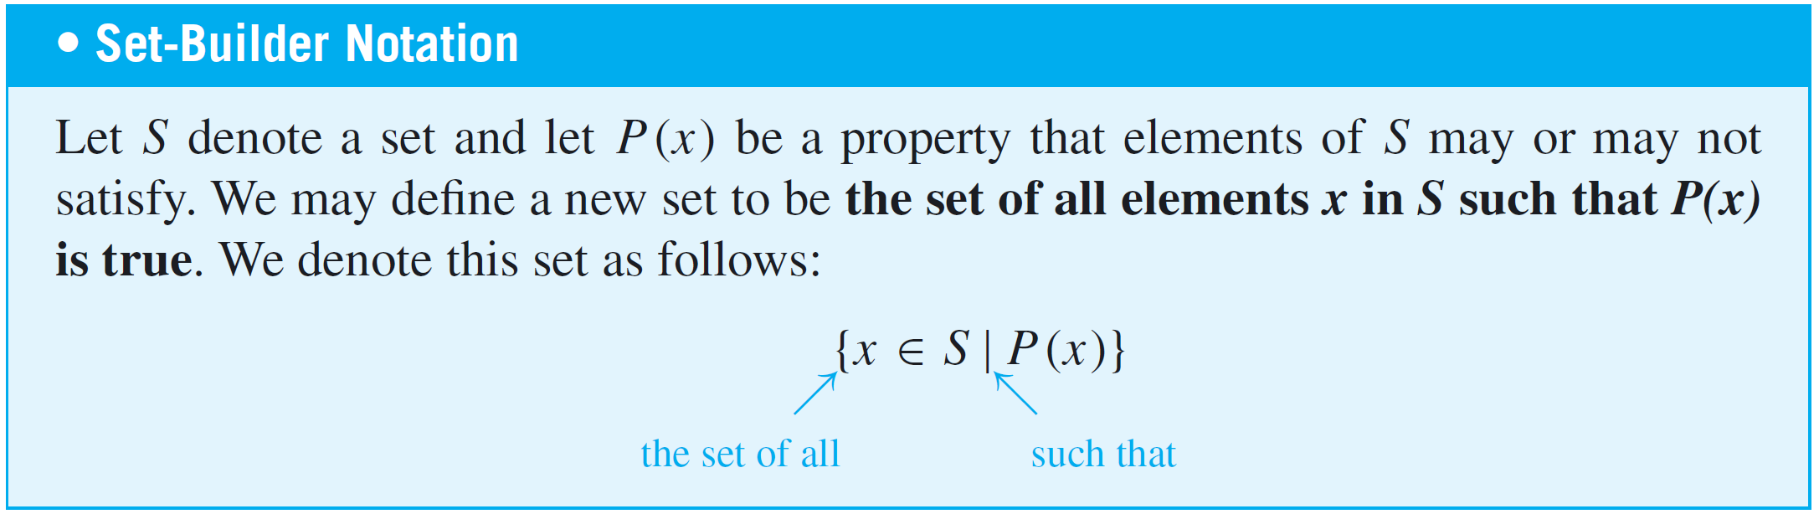
The Language of Sets
Thus every integer is a real number, and because the integers are all separated from each other, the set of integers is called discrete. The name discrete mathematics comes from the distinction between continuous and discrete mathematical objects.
Another way to specify a set uses what is called the set-builder notation.

Slide 13
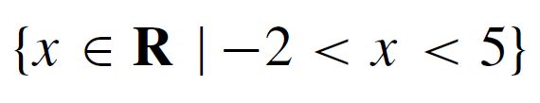


Example 2 – Using the Set-Builder Notation
Given that R denotes the set of all real numbers, Z the set of all integers, and Z⁺ the set of all positive integers, describe each of the following sets.
a.
b.
c.

Slide 14
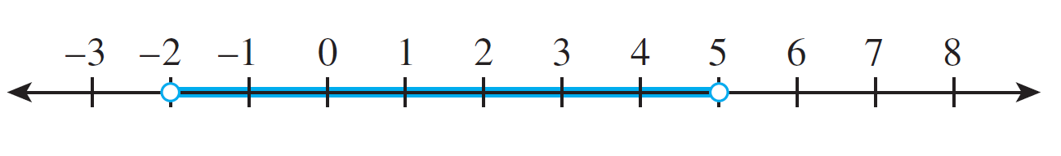
Example 2 – Solution
a. is the open interval of real numbers (strictly) between –2 and 5. It is pictured as follows:
b. is the set of all integers (strictly) between –2 and 5. It is equal to the set
{–1, 0, 1, 2, 3, 4}.
c. Since all the integers in Z⁺ are positive,

Slide 15
Subsets

Slide 16
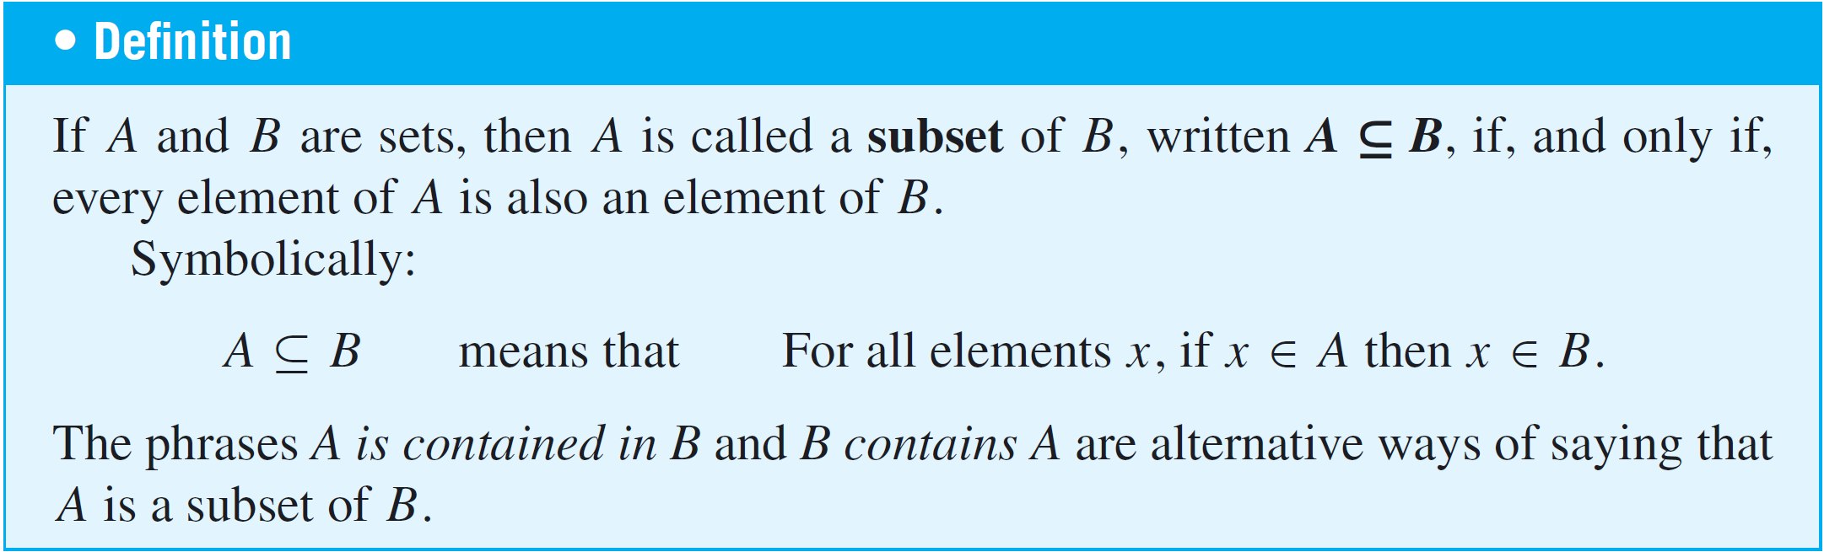
Subsets
A basic relation between sets is that of subset.

Slide 17
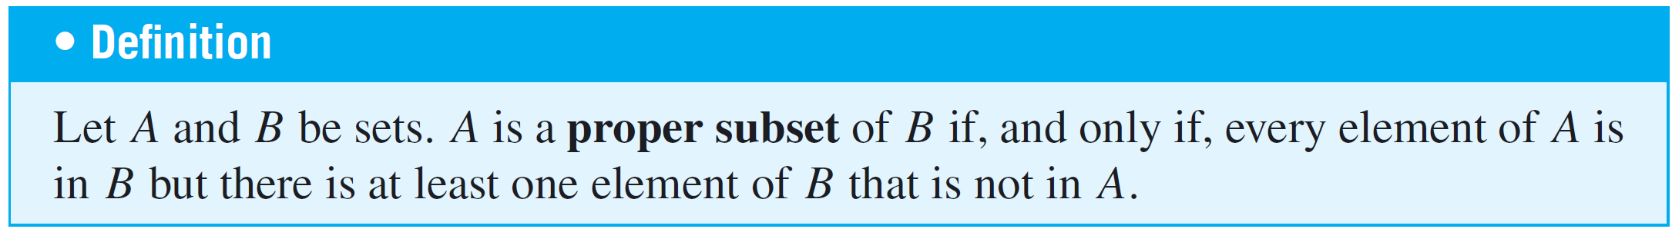
Subsets
It follows from the definition of subset that for a set A not to be a subset of a set B means that there is at least one element of A that is not an element of B.
Symbolically:

Slide 18
Example 4 – Distinction between ∈ and ⊆
Which of the following are true statements?
a. 2 ∈ {1, 2, 3} b. {2} ∈ {1, 2, 3} c. 2 ⊆ {1, 2, 3}
d. {2} ⊆ {1, 2, 3} e. {2} ⊆ {{1}, {2}} f. {2} ∈ {{1}, {2}}
Solution:
Only (a), (d), and (f) are true.
For (b) to be true, the set {1, 2, 3} would have to contain the element {2}. But the only elements of {1, 2, 3} are 1, 2, and 3, and 2 is not equal to {2}. Hence (b) is false.

Slide 19
Example 4 – Solution
cont’d
For (c) to be true, the number 2 would have to be a set and every element in the set 2 would have to be an element of {1, 2, 3}. This is not the case, so (c) is false.
For (e) to be true, every element in the set containing only the number 2 would have to be an element of the set whose elements are {1} and {2}. But 2 is not equal to either {1} or {2}, and so (e) is false.

Slide 20
Cartesian Products

Slide 21
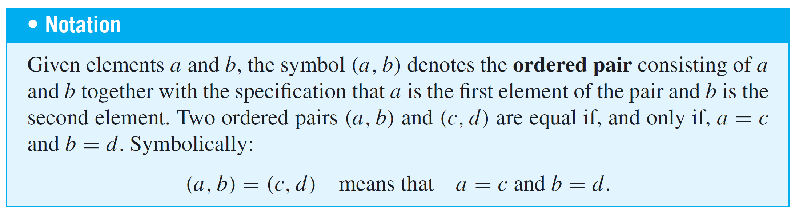
Cartesian Products

Slide 22
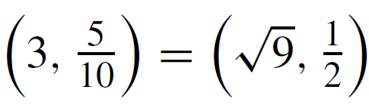
Example 5 – Ordered Pairs
a. Is (1, 2) = (2, 1)?
b. Is ?
c. What is the first element of (1, 1)?
Solution:
a. No. By definition of equality of ordered pairs,
(1, 2) = (2,1) if, and only if, 1 = 2 and 2 = 1.
But 1 ≠ 2, and so the ordered pairs are not equal.

Slide 23
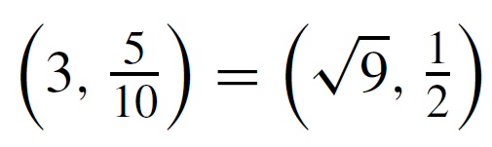


Example 5 – Solution
cont’d
b. Yes. By definition of equality of ordered pairs,
if, and only if, and
Because these equations are both true, the ordered pairs are equal.
c. In the ordered pair (1, 1), the first and the second
elements are both 1.

Slide 24
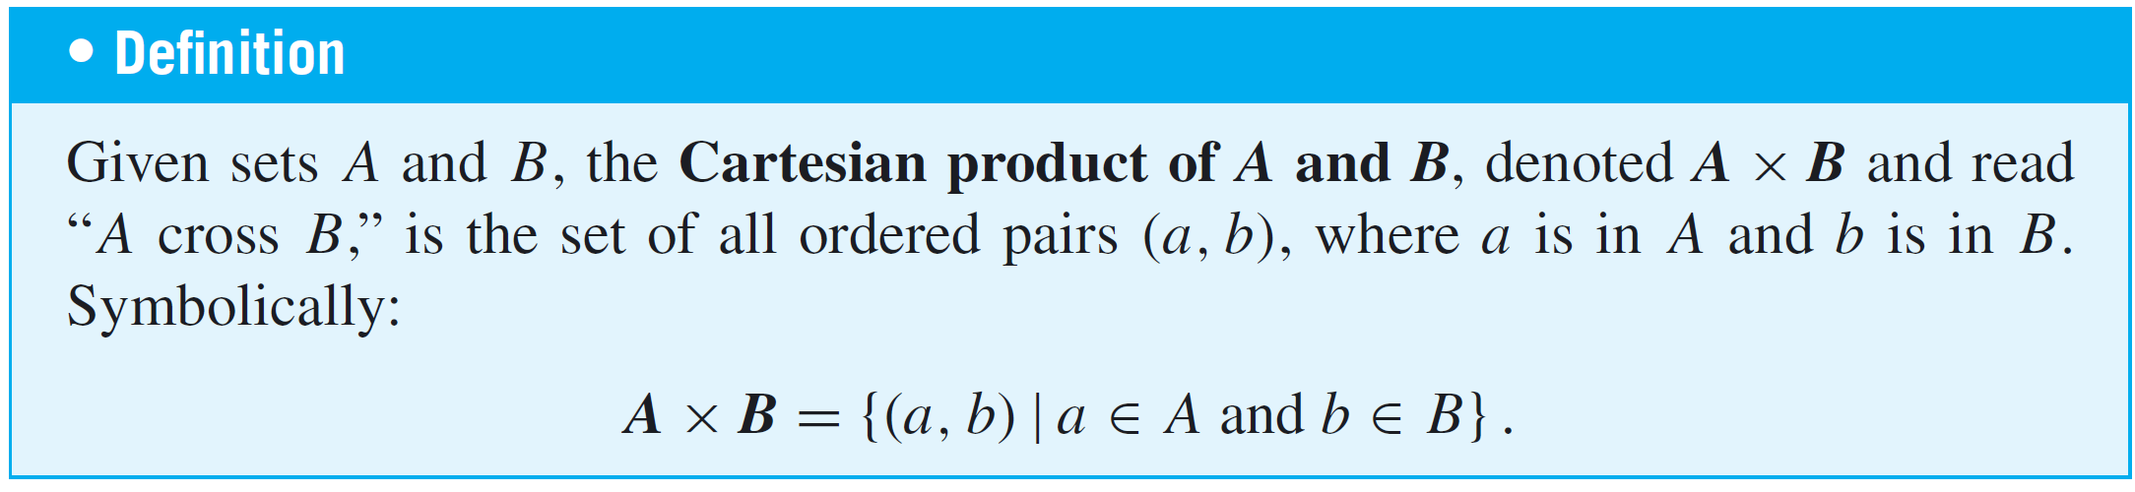
Cartesian Products

Slide 25
Example 6 – Cartesian Products
Let A = {1, 2, 3} and B = {u, v}.
a. Find A × B
b. Find B × A
c. Find B × B
d. How many elements are in A × B, B × A, and B × B?
e. Let R denote the set of all real numbers. Describe R × R.

Slide 26
Example 6 – Solution
a. A × B = {(1, u), (2, u), (3, u), (1, v), (2, v), (3, v)}
b. B × A = {(u, 1), (u, 2), (u, 3), (v, 1), (v, 2), (v, 3)}
c. B × B = {(u, u), (u, v), (v, u), (v, v)}
d. A × B has six elements. Note that this is the number of
elements in A times the number of elements in B.
B × A has six elements, the number of elements in B
times the number of elements in A. B × B has four
elements, the number of elements in B times the number
of elements in B.

Slide 27
Example 6 – Solution
cont’d
e. R × R is the set of all ordered pairs (x, y) where both x
and y are real numbers.
If horizontal and vertical axes are drawn on a plane and
a unit length is marked off, then each ordered pair in
R × R corresponds to a unique point in the plane, with
the first and second elements of the pair indicating,
respectively, the horizontal and vertical positions of the
point.

Slide 28
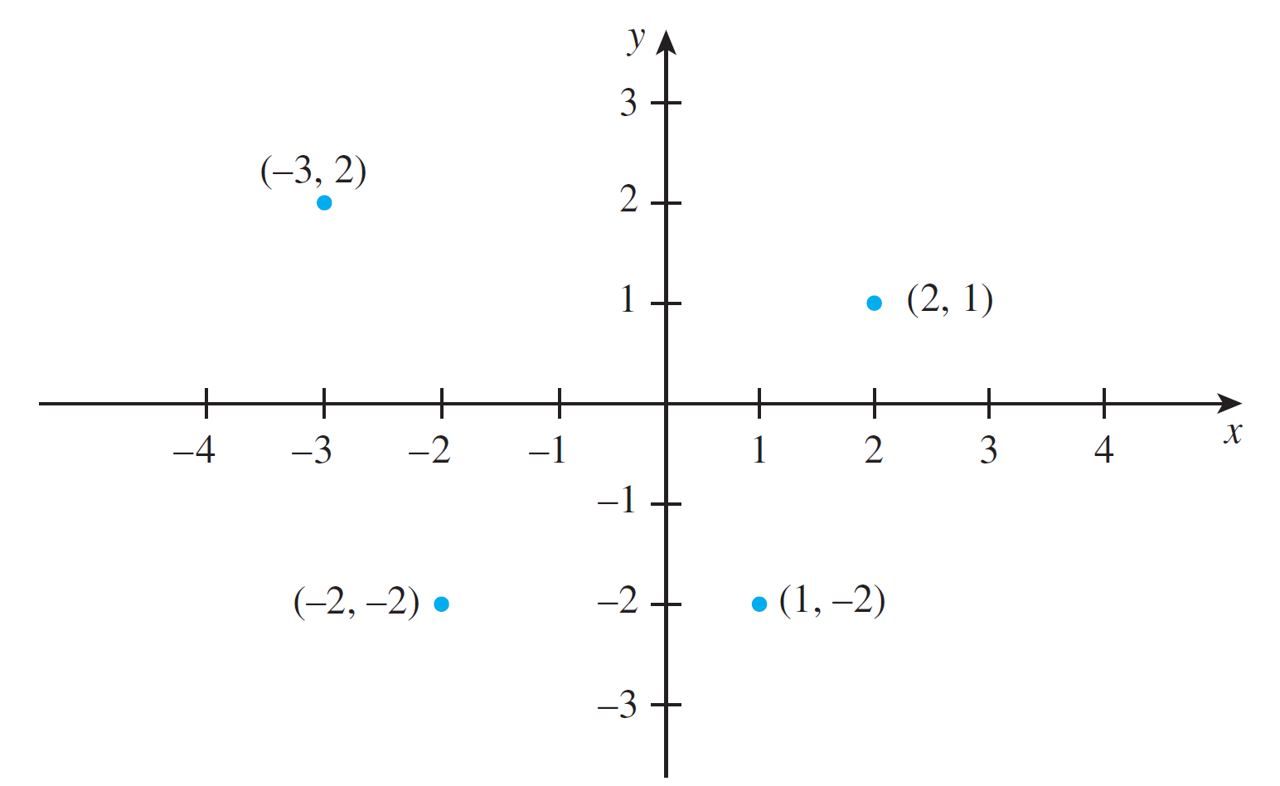
Example 6 – Solution
cont’d
The term Cartesian plane is often used to refer to a plane with this coordinate system, as illustrated in Figure 1.2.1.
A Cartesian Plane
Figure 1.2.1

